Slide 1


Artificial Neural Networks
DATA SCIENCE COMMUNITY SRM
NeuRes

Slide 2



Your speakers for today
Aarsh Chaube
Shinjinee Maiti

Slide 3

Overview of ANNs
Terms and notation
Forward Propagation
Topics for This
Session
Explanation and equations
Why we use activation functions
Reason for opting non-linearity
Backpropagation
Explanation and equations
Hands on session
Studying a pre-prepared Colab notebook

Slide 4
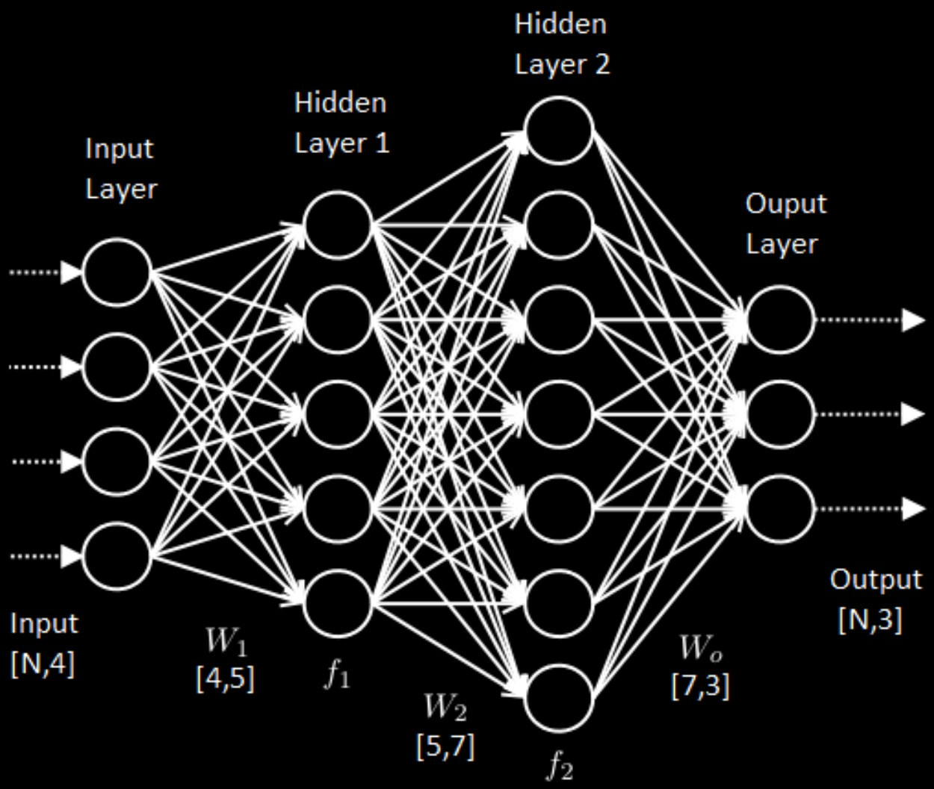

Artificial Neural Networks
Input layer: X neurons
Hidden layers: n^{[l]} neurons
Output layer: Y neurons
Weights: n^{[l-1]} × n^{[l]}
Biases: n^{[l]} × 1
j

Slide 5









Some notations:
Weight from neuron n of layer (l-1) to neuron m of layer l
Neuron m of layer l
Bias for neuron m of layer l
Weights from neurons of layer (l-1) to neuron m of layer l
Neurons of layer l
Biases for layer l
Weights from neurons of layer (l-1) to neurons of layer l

Slide 6





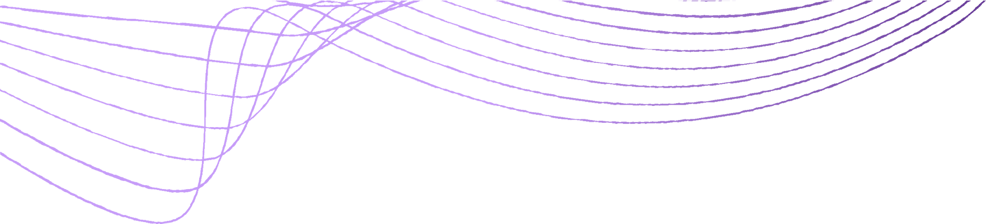
Forward Propagation
a₁^{[2]}
a₁^{[1]}
a₁^{[0]}
a₂^{[2]}
a₂^{[1]}
a₁^{[3]}
a₂^{[0]}
a₃^{[2]}
a₃^{[1]}
a₂^{[3]}
a₃^{[0]}
a₄^{[2]}
Layer 0
a₄^{[1]}
a₅^{[2]}
Layer 1
Layer 3
Layer 2

Slide 7
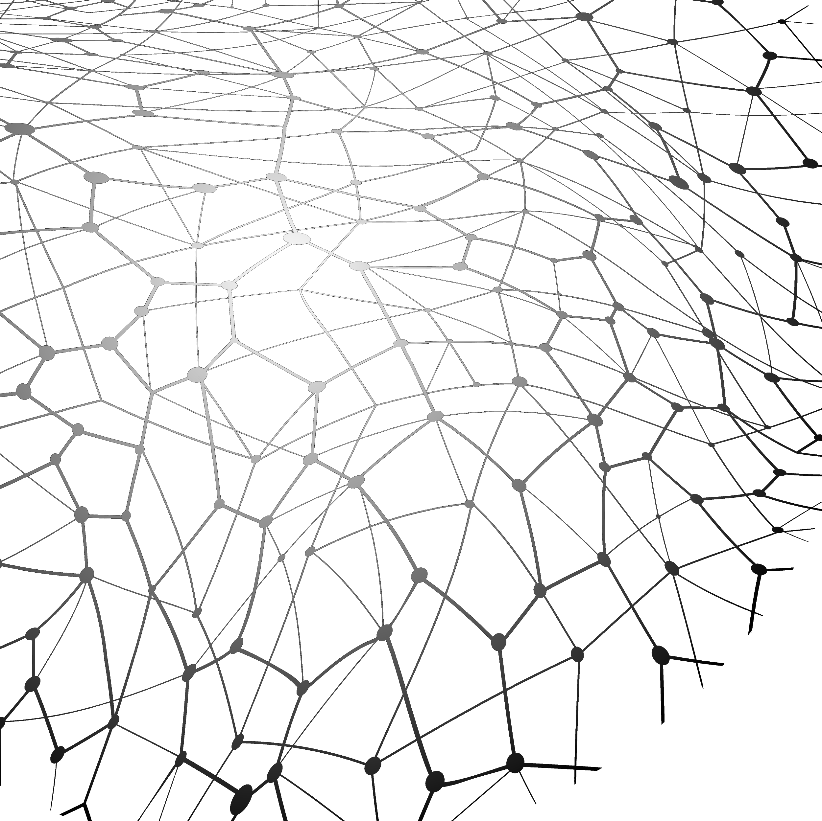







where,
where,
Forward Prop: Vectorized equations

Slide 8



Why we use activation functions
Having no activation function in the neural network units corresponds to using a Linear activation. Considering the network we were working with, suppose we don’t use any activation. Then the equations would be:
Clearly, we end up with a linear equation irrespective of the number of hidden layer we have. Hence it is important to use activation functions to introduce more scope for the network.

Slide 9














Backpropagation: Chain rule
We perform backpropagation to find the partial derivative of the cost function w.r.t. each of the weights. These derivatives, in turn, are used to update the weights using gradient descent or any other optimization algorithm. We compute them using the chain rule.
x₁
w₁
w₂
x₂
z
a
C
w₃
x₃
Here we consider 3 inputs and one neuron which has been divided into linear and activation parts for clarity.

Slide 10








a₁^{[2]}
a₁^{[1]}
a₁^{[0]}
a₂^{[2]}
a₂^{[1]}
a₁^{[3]}
a₂^{[0]}
a₃^{[2]}
a₃^{[1]}
a₂^{[3]}
a₃^{[0]}
a₄^{[2]}
Layer 3
Layer 0
a₄^{[1]}
a₅^{[2]}
Layer 1
Layer 2
Backpropagation
We take a look at the network we started with again.
So following the chain rule for backpropagation we will compute the derivative w.r.t. one of the weights, w₄₃^{[2]}, i.e., the weight from a₃^{[1]} to a₄^{[2]}. For simplification, we
denote,
as , as and so on.

Slide 11




Backprop: Vectorized equations
All the backpropagation computations are expressed in the form of vector equations that simplify the process both for humans and computers.
Here’s the generalized form considering layers l and (l-1):

Slide 12


Break time!
Head over to our discord server to interact with our community members!
Data Science Community Outer Circle
Do check out our other handles!
Email: datasciencecommunity@gmail.com
Instagram: dscommunity_srm
Twitter: dscommunity_srm
LinkedIn: Data Science Community SRM
YouTube: Data Science Community SRM

Slide 13
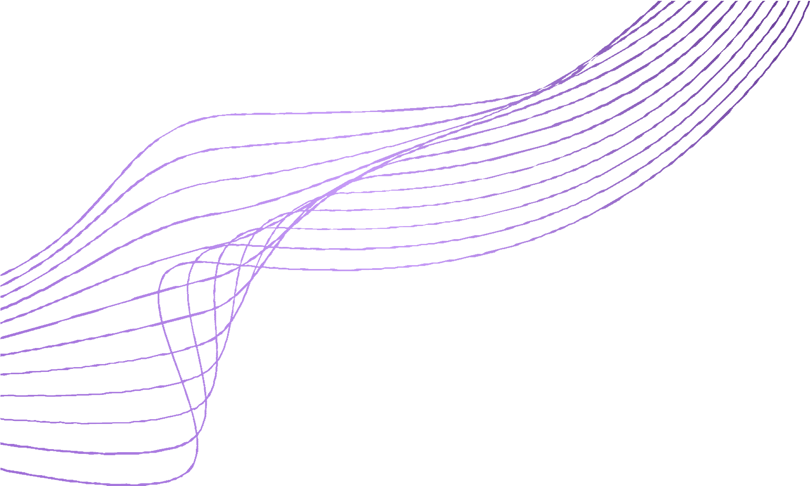

Random Initialization
Random initialization refers to initializing all the weights of the neural network to random values instead of the default zero.
If we initialize the weights as zero (symmetric weights),
All neurons perform the same calculation, that results in the same output, making the whole deep network useless.
The complexity of the whole network would become the same as a single neuron and the predictions would be random.
So the weights are initialized randomly, also known as breaking the symmetry.

Slide 14



Let’s Summarize: The Training Process
Forward it through the network to get predictions
Sample labelled data
Update the connection weights
Backpropagate the errors

Slide 15

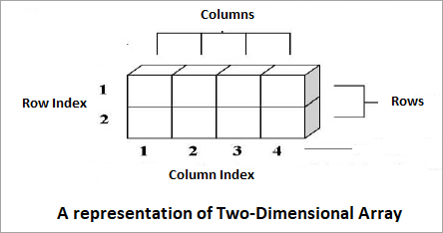
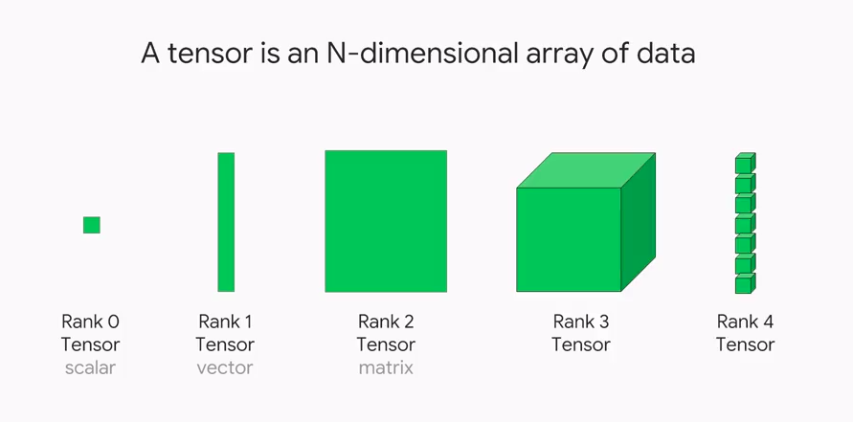
Prep-up for the Hands-on Session
What is TensorFlow?
TensorFlow is a free and open-source software library for machine learning. It can be used across a range of tasks but has a particular focus on training and inference of deep neural networks. Tensorflow is a symbolic math library based on dataflow and differentiable programming.
Understanding Tensors
Programming Perspective
Mathematical Perspective

Slide 16
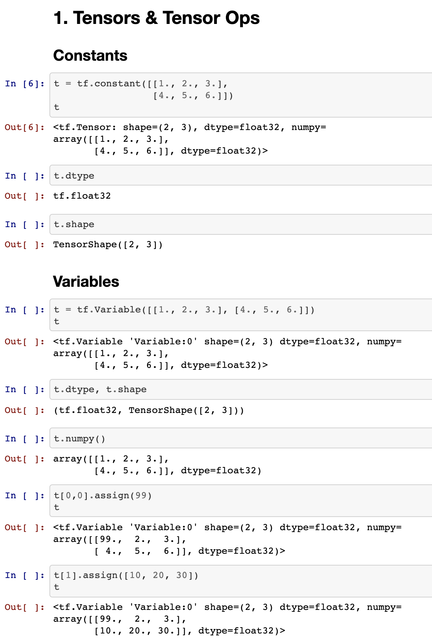
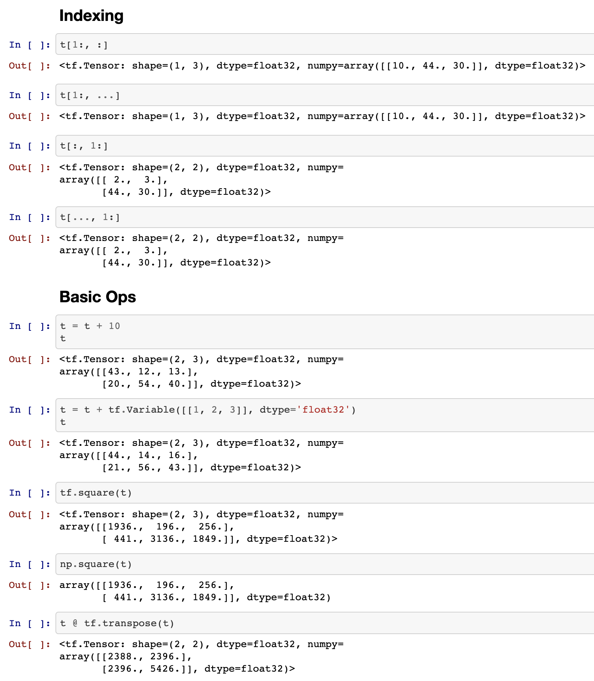

Slide 17


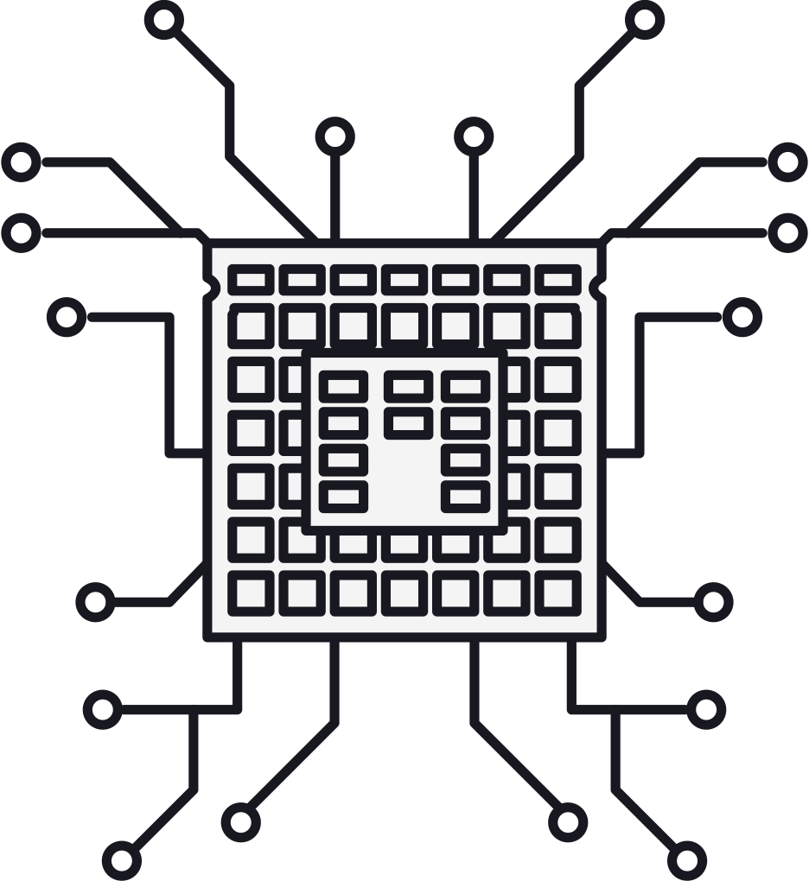
What is Keras?
Keras is a high-level library that uses TensorFlow as its backend. It provides an API (written in Python) for building Neural Networks. Developers use Keras to quickly build neural networks without worrying about the mathematical aspects of tensor algebra, numerical techniques, and optimization methods.
We have 3 ways we can create Keras models:
1. Sequential models: single-input, single-output, stacks of layers
2. Functional API: used in most cases, supports arbitrary model architectures
3. Model subclassing: used to implement everything from scratch

Slide 18



It's Hands-On Time!

Slide 19
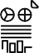





EMAIL
Get in touch with us!
Thank You!
datasciencecommunity@gmail.com
INSTAGRAM
dscommunity_srm
TWITTER
dscommunity_srm
LINKEDIN
Data Science Community SRM
YOUTUBE
Data Science Community SRM
DATA SCIENCE COMMUNITY SRM

